Slide 1


Slide 2

Why This Project?
Importance of HR Attrition Insights
Direct impact on talent retention & workforce stability
Helps HR identify risks, trends & retention strategies
Enables data-driven decisions

Slide 3




Project Overview
Consolidates employee data in one interactive dashboard
Combines KPI cards, charts & demographic breakdowns
Highlights who is leaving, why, and where improvements are needed

Slide 4
Project Context
Business Challenges
Difficulty linking attrition to satisfaction & performance
High attrition increases hiring costs
Poor visibility by demographics & job roles

Slide 5
【Dashboard Purpose】
Centralizes employee data
Provides real-time visual trends
Enables HR to make evidence-based decisions quickly

Slide 6
Key Considerations
Design Focus
c
c
Workforce diversity across departments
Segmentation by age, gender, education
Employee satisfaction & retention strategies
Scalability for future HR datasets

Slide 7
Project Objectives
Measure job satisfaction impact
Visualize overall attrition & department trends
Support HR strategies for retention & engagement
Understand employee demographics

Slide 8




Target Audience
Who Benefits
HR Leaders & Managers
Business Executives
Talent Acquisition Teams
Data Analysts

Slide 9
Business Problems
Problems Addressed
❌ Lack of visibility by age, gender, department
❌ Hidden drivers of attrition
❌ Reactive HR strategies
✅ Solution: Interactive Tableau dashboard + KPI visuals

Slide 10


Key Features
Dashboard Highlights
Age distribution (Bar chart)
KPI Cards: Employee count, attrition rate, active employees
Gender-based attrition trends
Job satisfaction heatmap
Department-wise attrition (Pie chart)

Slide 11
KPIs
Key Metrics
Employee Count: 1,470
Active Employees: 1,233
Attrition Count: 237
Average Age: 37 years
Attrition Rate: 16.12%

Slide 12

Filters for Insights
Customizable Filters
4567
Gender: Male / Female
Department: HR, R&D, Sales
Education Field
Age Group
45832
645832
645832

Slide 13

Interactivity Features
Dashboard Interactivity
Clickable segments to filter visuals
Hover tooltips for exact counts & percentages
Auto-updates on filter selection

Slide 14
Project Lifecycle
Dashboard Design →
KPIs, charts & filters
Data Collection →
Employee demographics & satisfaction
Deployment →
Tableau workbook & snapshots
Data Cleaning →
Remove duplicates, handle nulls
Data Modeling →
Joins & calculated fields

Slide 15
Key Business Takeaways
Sales department has highest attrition (56%)
Younger employees (25–34) have higher attrition risk
Life Sciences graduates show largest attrition group
Low satisfaction roles correlate with higher attrition

Slide 16
【Tools & Technologies】
Tool Purpose
Tableau Public Dashboard creation & interactivity
Excel/CSV Data source
Power Query/SQL Preprocessing & cleaning
PNG Export Dashboard snapshots

Slide 17
Strategic Recommendations
Focus retention efforts on Sales department
Improve job satisfaction programs
Tailor policies for Life Sciences graduates
Address attrition in younger workforce (25–34)

Slide 18

Future Scope
【Next Steps】
Integrate with live HRMS for real-time tracking
Develop mobile-friendly version
Add predictive analytics
Expand analysis with geographical insights

Slide 19
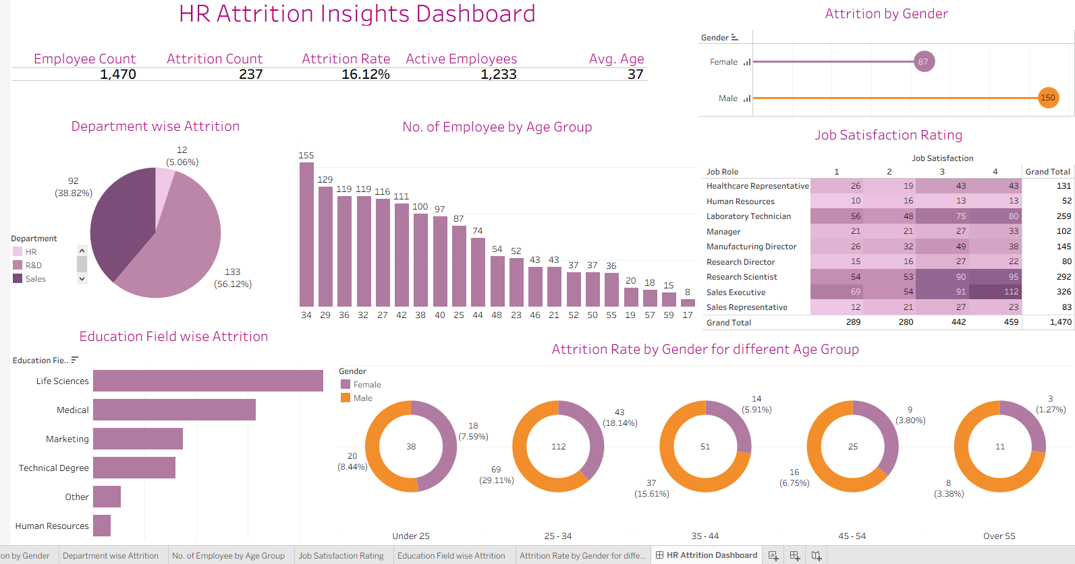
【Dashboard Snapshot】

Slide 20

【Visual Preview】

Slide 21

Every great presentation is complete with a great audience
— and that’s you!

